Slide 1
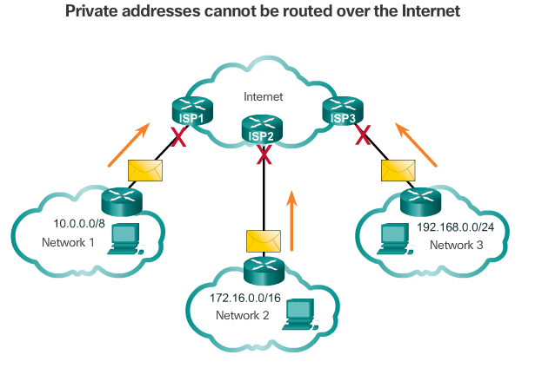
Public and Private IPv4 Addresses
Private Addresses:
10.0.0.0/8 or 10.0.0.0 to10.255.255.255
172.16.0.0 /12 or 172.16.0.0 to 172.31.255.255
192.168.0.0 /16 or 192.168.0.0 to 192.168.255.255
Notes:
7.1.4.1 Public and Private IPv4 Addresses
7.1.4.2 Activity – Pass or Block IPv4 Addresses

Slide 2
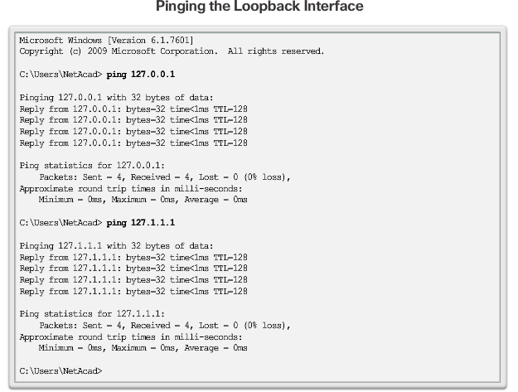
Special Use IPv4 Addresses
Loopback addresses 127.0.0.0 /8 or 127.0.0.1 to 127.255.255.254
Link-Local addresses or Automatic Private IP Addressing (APIPA) addresses 169.254.0.0 /16 or 169.254.0.1 to 169.254.255.254
TEST-NET addresses 192.0.2.0/24 or 192.0.2.0 to 192.0.2.255
Notes:
7.1.4.3 Special Use IPv4 Addresses

Slide 3
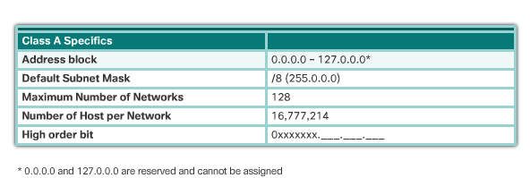
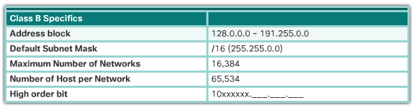
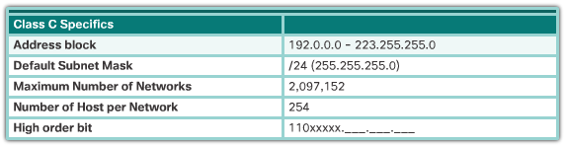
Legacy Classful Addressing
Notes:
7.1.4.4 Legacy Classful Addressing
7.1.4.5 Video Demonstration - Classful IPv4 Addressing

Slide 4
Classless Addressing
Formal name is Classless Inter-Domain Routing (CIDR, pronounced “cider”).
Created a new set of standards that allowed service providers to allocate IPv4 addresses on any address bit boundary (prefix length) instead of only by a class A, B, or C address.
Notes:
7.1.4.6 Classless Addressing

Slide 5
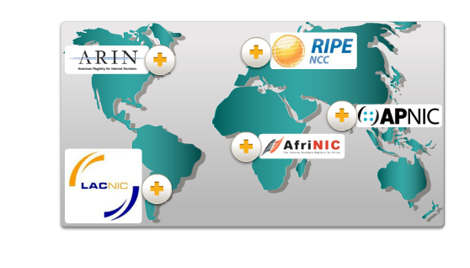
Assignment of IP Addresses
Notes:
7.1.4.7 Assignment of IP Addresses
7.1.4.8 Activity – Public or Private IPv4 Address
7.1.4.9 Lab – Identifying IPv4 Addresses

Slide 6
Section 7.2: IPv6 Addresses
Upon completion of this section, you should be able to:
Explain the need for IPv6 addressing.
Describe the representation of an IPv6 address.
Describe types of IPv6 network addresses.
Configure global unicast addresses.
Describe multicast addresses.

Slide 7
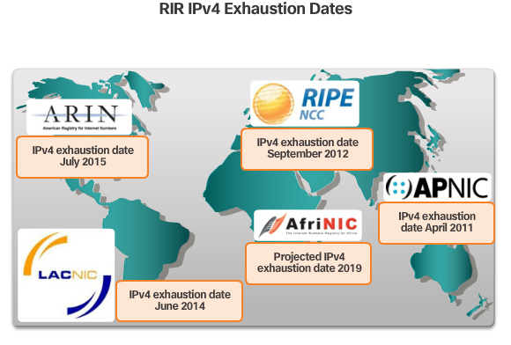
The Need for IPv6
Notes:
7.2.1.1 The Need for IPv6

Slide 8
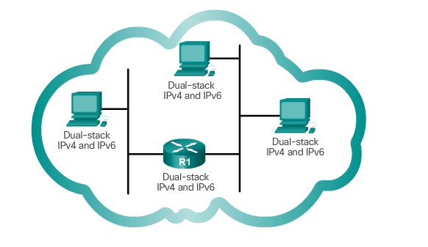
IPv4 and IPv6 Coexistence
The migration techniques can be divided into three categories: Dual Tack, Tunneling, and Translation.
Dual-stack allows IPv4 and IPv6 to coexist on the same network. Devices run both IPv4 and IPv6 protocol stacks simultaneously.
Notes:
7.2.1.2 IPv4 and IPv6 Coexistence

Slide 9
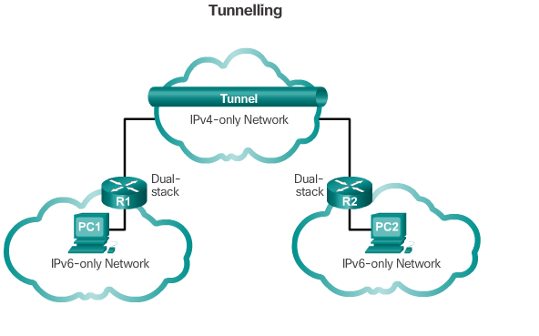
IPv4 and IPv6 Coexistence (cont.)
Tunneling is a method of transporting an IPv6 packet over an IPv4 network. The IPv6 packet is encapsulated inside an IPv4 packet.
Notes:
7.2.1.2 IPv4 and IPv6 Coexistence (Cont.)

Slide 10
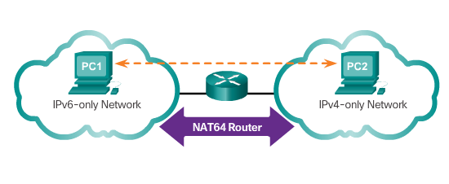
IPv4 and IPv6 Coexistence (cont.)
Translation: Network Address Translation 64 (NAT64) allows IPv6-enabled devices to communicate with IPv4-enabled devices using a translation technique similar to NAT for IPv4. An IPv6 packet is translated to an IPv4 packet, and vice versa.
Notes:
7.2.1.2 IPv4 and IPv6 Coexistence (Cont.)
7.2.1.3 Activity - IPv4 Issues and Solutions

Slide 11
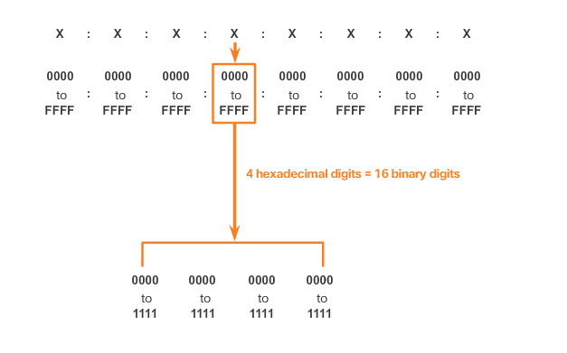
IPv6 Address Representation
Hextets – 4 Hexadecimal digits = 16 binary digits
Notes:
7.2.2.1 IPv6 Address Representation

Slide 12
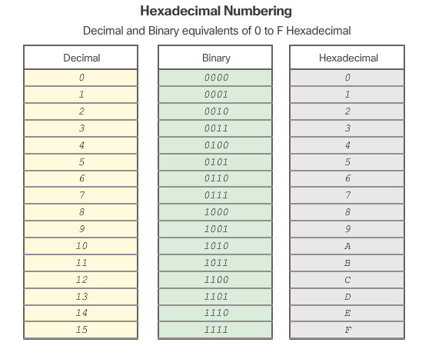
IPv6 Address Representation (cont.)
Notes:
7.2.2.1 IPv6 Address Representation (Cont.)

Slide 13
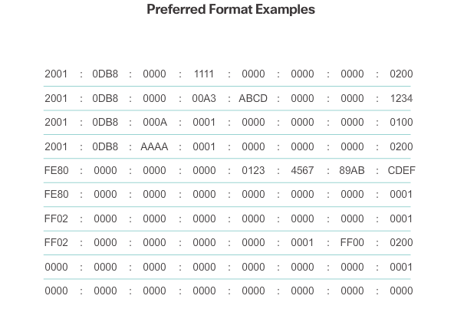
IPv6 Address Representation (cont.)
Notes:
7.2.2.1 IPv6 Address Representation (Cont.)

Slide 14
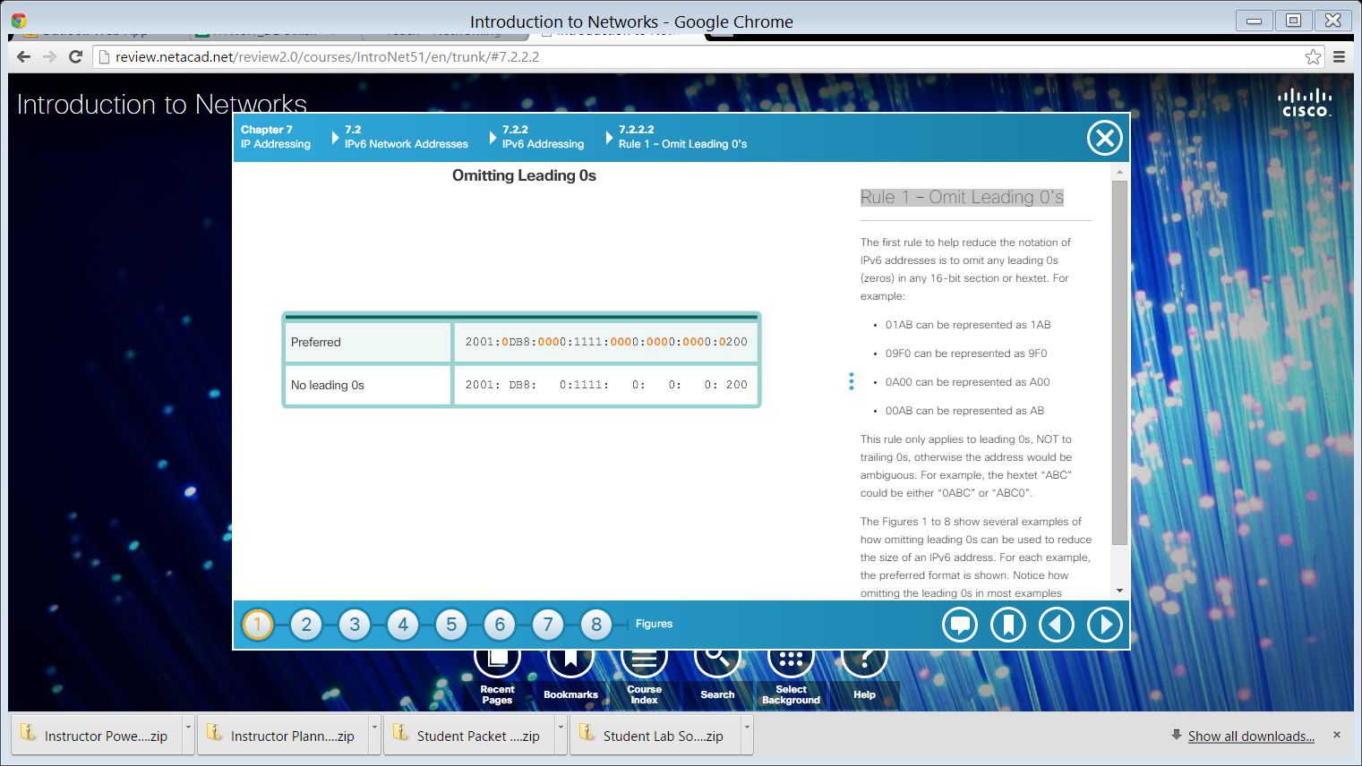


Rule 1 – Omit Leading 0’s
Example 1
Example 2
Example 3
Notes:
7.2.2.2 Rule 1 – Omit Leading 0’s

Slide 15

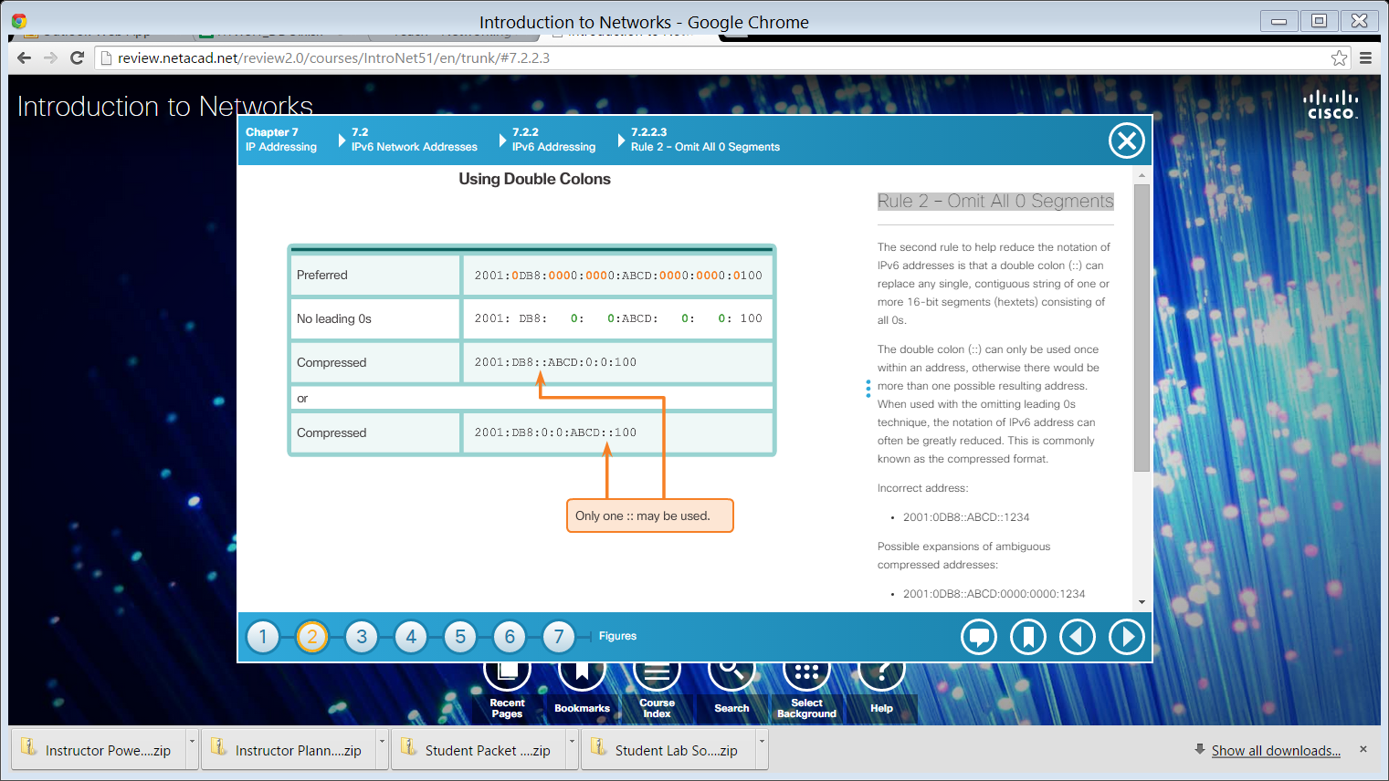
Rule 2 – Omit All 0 Segments
Example 1
Example 2
Notes:
7.2.2.3 Rule 2 – Omit All 0 Segments

Slide 16


Rule 2 – Omit All 0 Segments (cont.)
Example 3
Example 4
Notes:
7.2.2.3 Rule 2 – Omit All 0 Segments (Cont.)
7.2.2.4 Activity – Practicing IPv6 Address Representations

